Slide 1
Ontario Environmental Polluters
Group 3
Zeeshan Gazi, Shay Houseknecht, Ever Hughes, Khushil Nagda, Ivanka Tkachenko

Slide 2

Topic: GHG Activity in Ontario
Understanding where environmental pollution in Ontario stems from
Spatially
Industry, company
Temporal changes
Mapping pollution sources and flows
Pollution hotspots
Where pollution settles (wind patterns, still water, etc.)
(Government of Canada, 2023)
Notes:
The core of our project revolves around the exploration of greenhouse gas emissions in Ontario. We aim to peel back the layers of data to reveal the primary sources of these emissions.
Our focus is twofold:
identifying the industries and companies responsible for the most significant contributions to pollution, and
pinpointing the regions within Ontario that bear the brunt of these emissions.
But we don't stop there. We're also delving into how these emission levels have evolved over time, providing a dynamic view of pollution trends.

Slide 3



Topic: GHG Activity in Ontario
Understanding where environmental pollution in Ontario stems from
Spatially
Industry, company
Temporal changes
Mapping pollution sources and flows
Pollution hotspots
Where pollution settles (wind patterns, still water, etc.)
Social impacts
Public education -> make informed decisions
Social Good
Rising GHG emissions have numerous social impacts (health, environment, economy)
Greater impact on vulnerable communities
Stress on health systems, mental health
(Government of Canada, 2023)
Notes:
Why is this important, you may ask?
The reasons are manifold.
Rising GHG emissions have profound impacts on our health, the environment, and the economy.
These emissions contribute to worsening air quality, climate change, and extreme weather events, which in turn have a greater impact on vulnerable communities.
Our goal is to empower the audience to be able to make informed decisions about their own life and the environment they live in.

Slide 4



Target Audience
Our audience:
Ontario citizens
Government officials
An accessible online tool for a general audience
Provide public with GHG information
Display data in an easy-to-understand visual format
Notes:
Since we want to empower everyone to make informed decisions, our intended audience for this visualization is Ontario citizens from all science backgrounds.
This tool could also be used to communicate climate change issues to government officials.
We want the visualization to be accessible to people of all knowledge levels on the topic to be able to provide information to the general public.
The data should be communicated in an engaging, understandable format.

Slide 5

Importance of Understanding GHG
Most Canadians are concerned about climate change, especially young people
(Rabson, 2023)
Company GHG emissions directly affect Ontario citizens through environmental, health, and economic impacts
Ex. Increases in temperature, precicipation, respiratory illness and disease, disruption of industry (Government of Canada, 2023)
Possible questions:
Which economic sectors in Ontario are the worst polluters?
Which companies are contributing the most greenhouse gas emissions in Ontario?
What cities have the worst greenhouse gas footprint?
Notes:
This is an important topic– most canadians are concerned about climate change.
The GHG emissions of companies in Ontario have direct consequences on the environment, public health, and the economy.
Some questions we want Ontario citizens to be able to find answers to with our visualization are:
What are the sources behind GHG emissions in Ontario?
What specific chemicals are being released into the environment? how much? How harmful are they?
What companies are producing the most GHG emissions. What industries are they in?
Are those numbers changing?
Finally, what locations in Ontario have the greatest GHG footprint? Is there a spatial pattern? Both in terms of emitters and absorbers.

Slide 6
GHG Data: Details
Data Source: The Ministry of the Environment, Conservation and Parks
There are 2948 observations, over 11 years. In our data we will focus on the following characteristics:
Note that Emissions are in million metric tonnes.
 | ID of Facility | City | CO2 Emissions
Unique Values | 429 | 163 | 2888
Range | 1001 - 1528 | Ontario | 0 - 8,593,656
Year | Facility Name | Industry Code | Other Emissions
Notes:
We will be utilizing a data set from The Ministry of the Environment, Conservation and Parks which describes data from regulated facilities under the Environmental Protection Act.
Our dataset includes information about the facilities, including:
its name and owner,
industry codes
CO2 emissions + other emissions we may or may not use

Slide 7
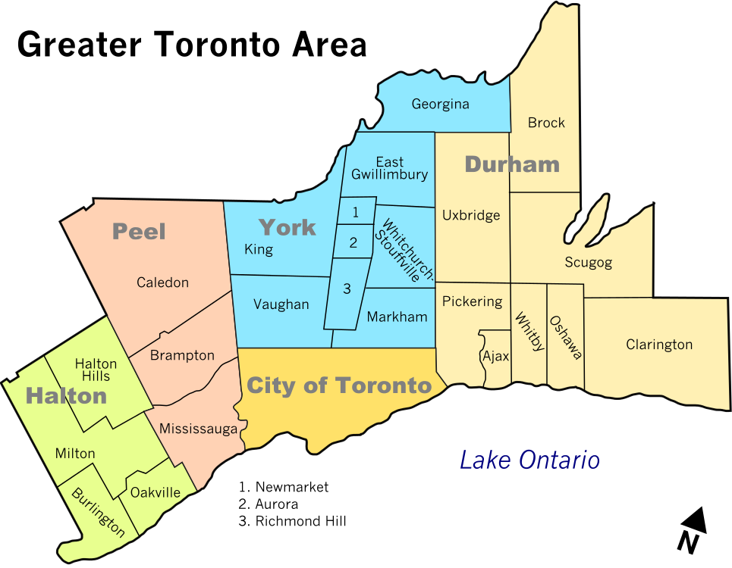
Merging Data: Ideas
Adding other temporal & spatial data sets
water contamination, stream flows
health indicators
air quality
Notes:
Because we want to show spatial and temporal flows about the environment as a whole, we’re planning to augment this dataset with similarly structured data from the Ontario government.
Ideas we’re considering include:
water contamination, flows of water across Ontario
health indicators, geographical distribution across Ontario
air quality, movements of carbon emissions to see where they tend to stagnate and land

Slide 8
References
Government of Canada. (2023, April 14). Greenhouse gas emissions: drivers and impacts. https://www.canada.ca/en/environment-climate-change/services/environmental-indicators/greenhouse-gas-emissions-drivers-impacts.html
Rabson, M. (2023, September 13). 7 in 10 canadians worried about climate change, poll suggests. CBC. https://www.cbc.ca/news/politics/majority-canadians-worried-about-climate-change-1.6964334#:~:text=A%20large%20majority%20of%20Canadians,a%20new%20national%20poll%20suggests
The Ministry of the Environment, Conservation and Parks. (2022). 2010-2021 specified GHG activities. [Data set]. https://files.ontario.ca/moe_mapping/downloads/1Air/GHG_by_year/GHG_Data_2010_2021_data_Oct2123.csv

